Slide 1
Role of non-CO2 greenhouse gas emissions in limiting global warming
GGGS 621

Slide 2

Biography
Dr. Yang Ou is an Assistant Professor at Peking University (PKU) in China. Before joining PKU, Yang was an Earth Scientist at the Pacific Northwest National Laboratory and an Assistant Research Scholar at the University of Maryland. Yang obtained his Ph.D. in Environmental Science and Engineering from the University of North Carolina at Chapel Hill and an M.S. in Mechanical Engineering from Carnegie Mellon University. Yang's research spans energy system modeling, greenhouse gas mitigation, air pollution control, and climate policy analysis from global to sub-national scales. Yang is also a developer of the Global Change Analysis Model (GCAM) and its regional sub-models (GCAM-USA and GCAM-China). His research has been published in high-profile journals such as Science, Nature Climate Change, Nature Communications, and PNAS.
Prof. Yang Ou Assistant Professor
Department of Environmental Management
Peking University

Slide 3
Lecture

Slide 4

Break

Slide 5
Agenda
1:00 Emission systems
Today’s Lecture
Q&A
2:15 Break
2:30 GCAM Tutorial
Paper Critique
Recap of Previous Lecture
Discuss Previous Assignment
New modeling assignment

Slide 6
Paper Critique

Slide 7
Housekeeping
Syllabus updated with new readings and new CDR session
Zoom guest lecture on 9/27
Please submit paper critique slides to TA
TA office hours: Monday 2-4 pm N5

Slide 8
Course schedule and topics
Date | Lecture Topic (w/ Guest Speaker) | Readings | What’s Due | Paper Critique
8/30 | Introduction to IAM | Reading 1 |  | -
9/6 | Foundations of IAM | Reading 2 | Assignment 1 | -
9/13 | Energy System | Reading 3 |  | -
9/20 | Land System | Reading 4 | Assignment 2 | 박소민
9/27* | Emission System (Prof. Yang Ou) | Reading 5 | Assignment 3 | 조정호
10/4 | GHG Removal | Reading 6 | Assignment 4 | 안지석
10/11 | Water System | Reading 7 |  | 최지우
10/18 | Mid-Term: Project Proposal |  | Project proposal
10/25 | IAM in International Climate Policies | Reading 8 |  | Nguyen
11/1 | Standardized Scenarios | Reading 9 | Assignment 5 | Ahmed
11/8 | Multi-model Comparison | Reading 10 | Assignment 6 | Pei Jia
11/15* | IAM in National Strategies (TBD) | Reading 11 | Assignment 7 | Andhika
11/22 | Mitigation and other SDGs | Reading 12 | Assignment 8 | 이정미
11/29 | Uncertainty in IAM and Climate Change | Reading 13 |  | 박시은
12/6 | Food-Energy-Water Nexus | Reading 14
12/13 | Final project presentation 1 |  | Presentation

Slide 9
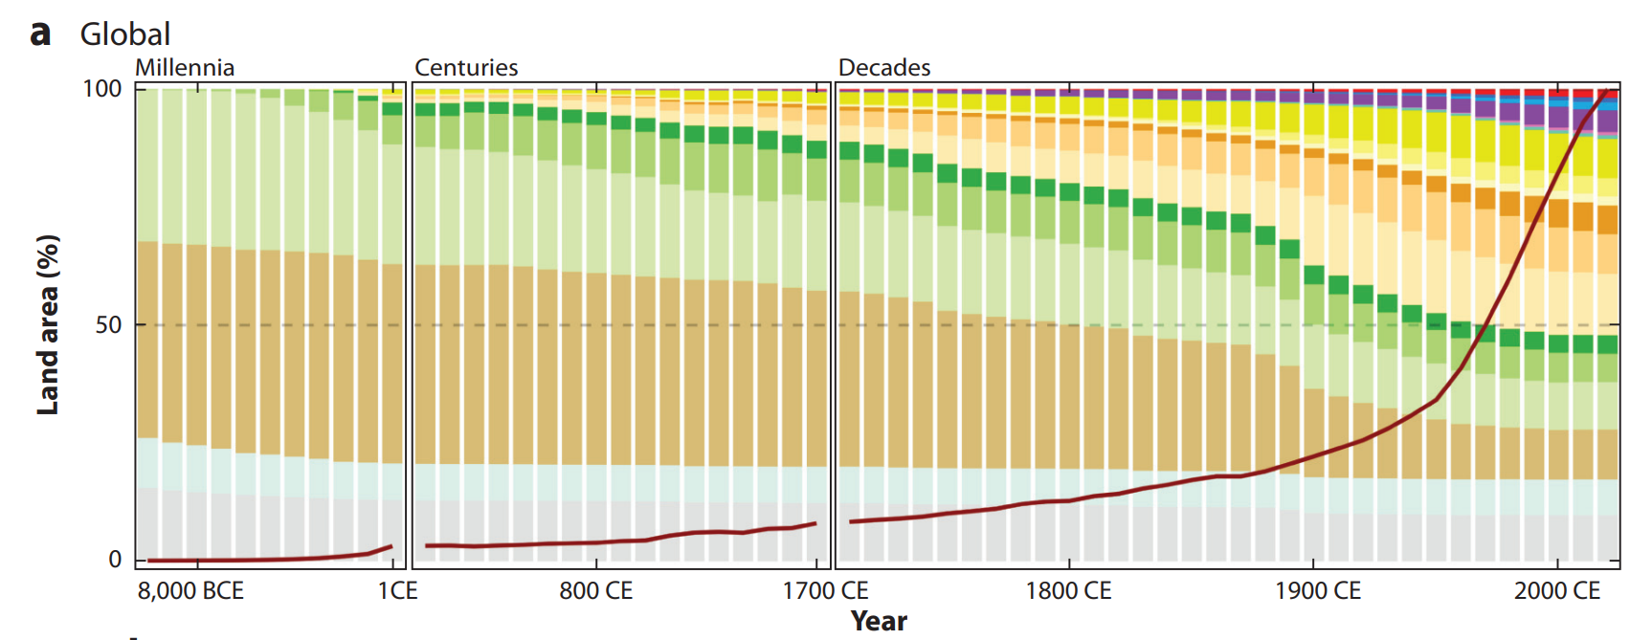
Land use over time: past 12,000 years (HYDE)
1 Bha forest loss
Biodiversity
Water cycle
LUC emissions
Ag-land expansion slows
Ellis (2021); Goldewijk et al. (2017)

Slide 10
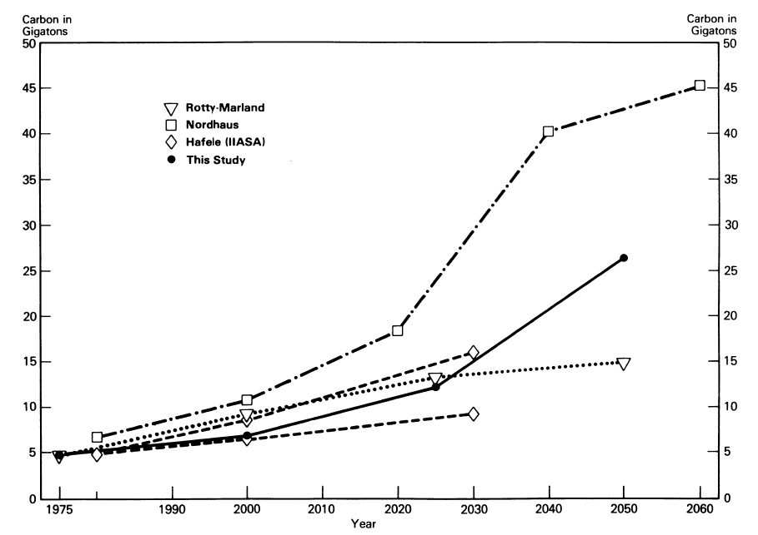
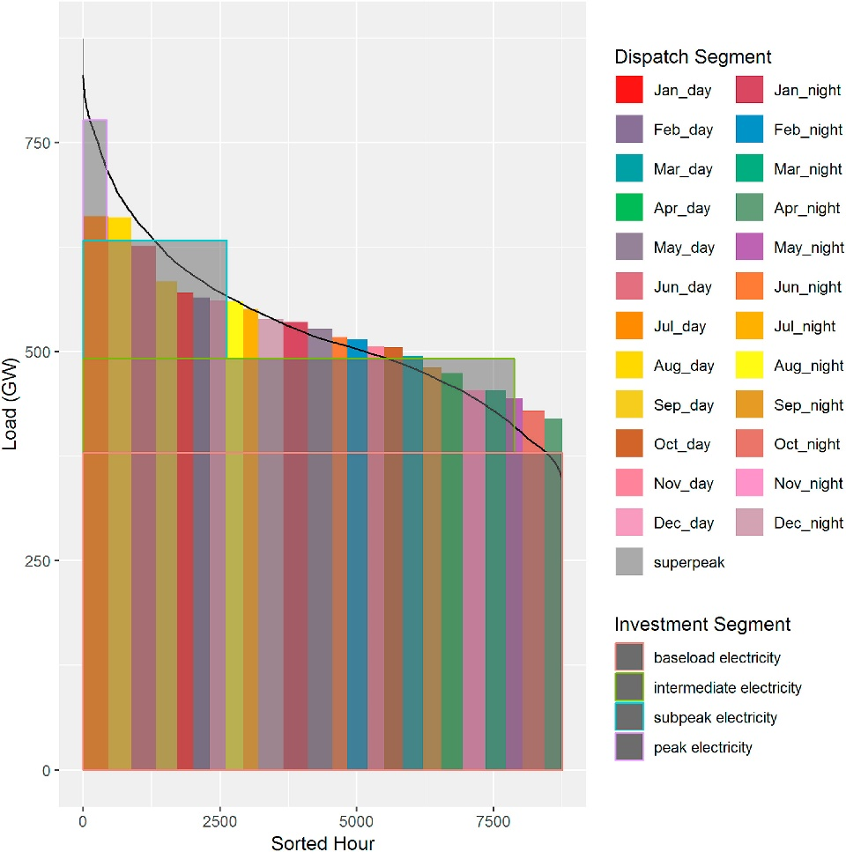
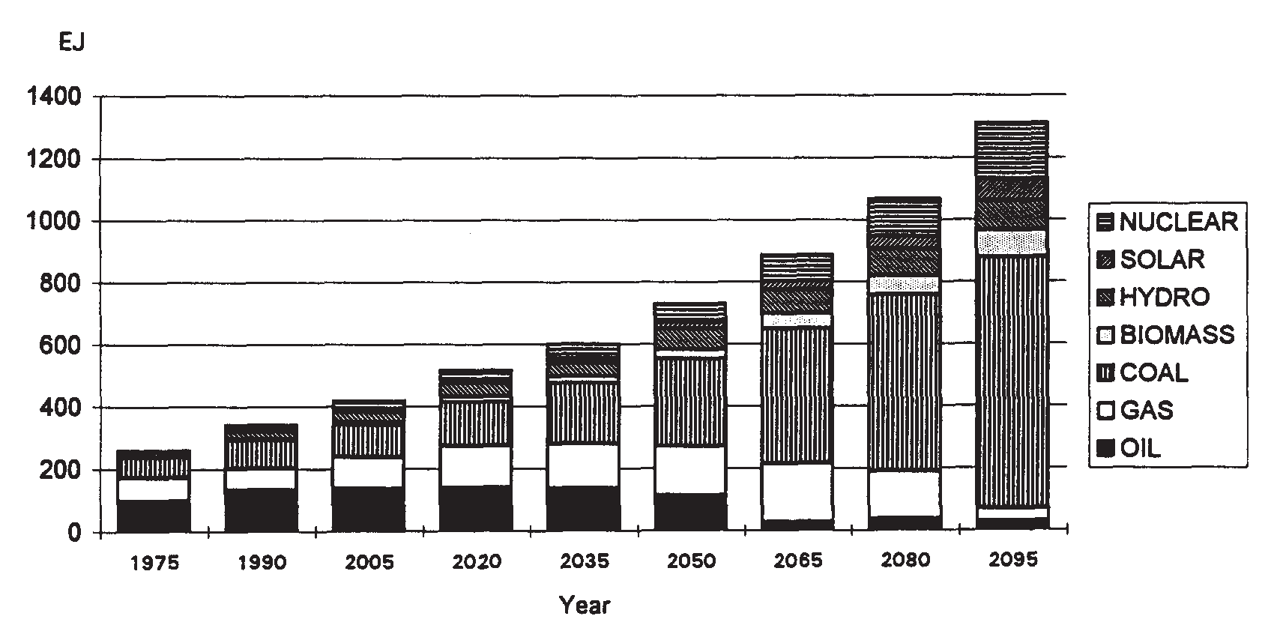
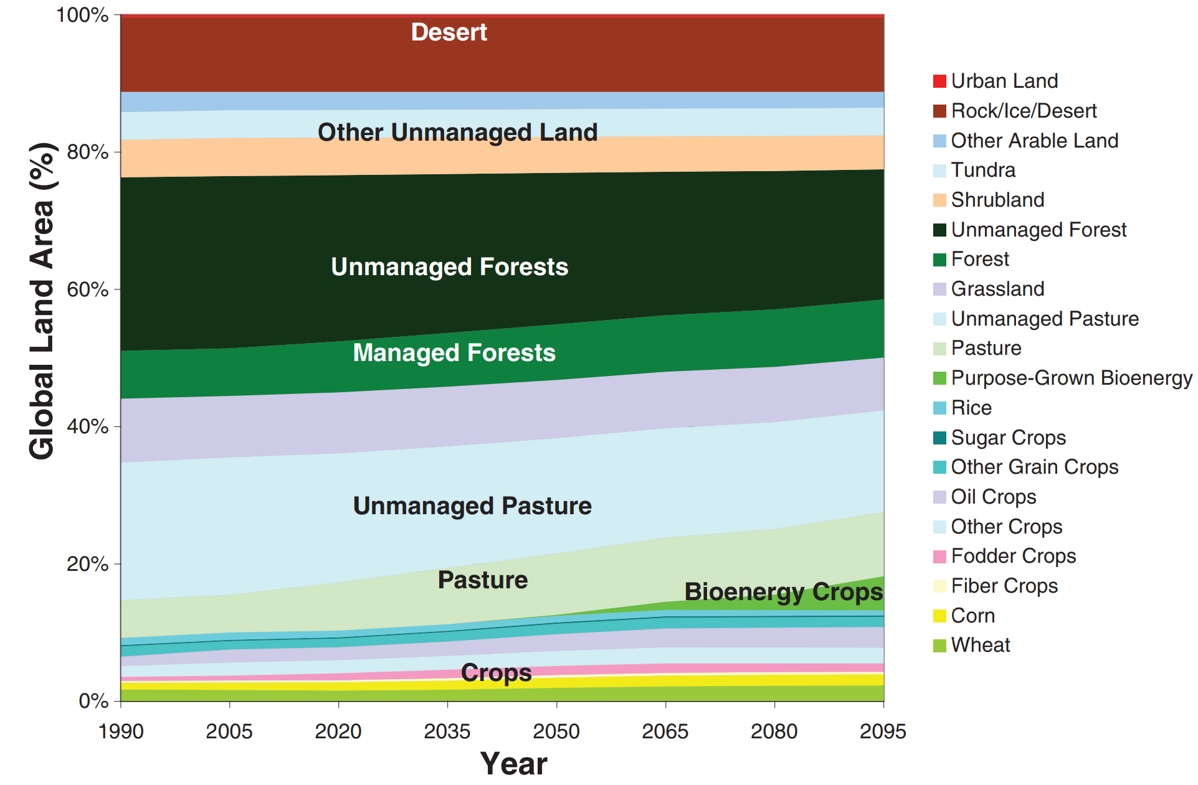
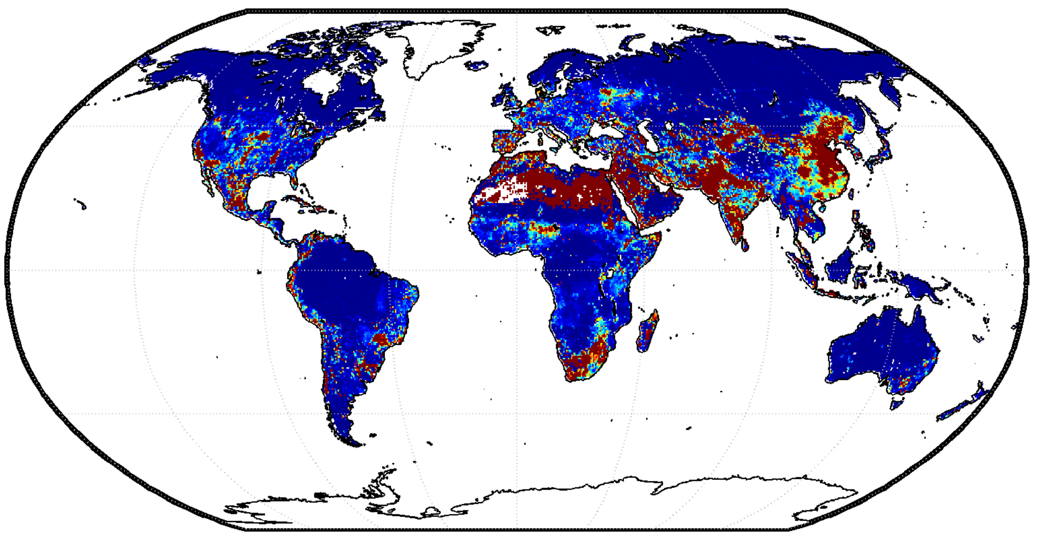
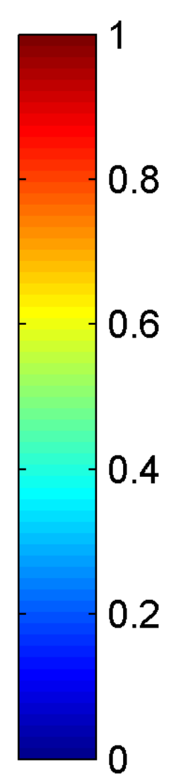




The Evolution of GCAM Research
1980s
Projections of emissions and concentrations
Understanding the complex interactions among energy, water, land, climate, socioeconomics, and other important human and natural systems at regional to global scales
2015–Present
Integrating impacts
Edmonds and Reilly (1983). The Energy Journal.
Wise et al. (2019). ESR.
1990s
2010s
Energy and Technology
2000s
Water system
Land use system
Water Scarcity Index
Edmonds et al. (1995).
Energy Policy.
Wise et al. (2009).
Science.
Hejazi et al. (2014). HESS.
ENERGY-ECONOMY-CLIMATE
ENERGY-ECONOMY-LAND-CLIMATE
ENERGY-ECONOMY-LAND-WATER-CLIMATE

Slide 11
How do bioenergy and land policies affect the land system?
Land Cover in 2095 in Reference and 3.7 W/m²
Calvin et al. (2014)

Slide 12
GCAM Tutorial

Slide 13
Assignment #3
Run a GCAM low-emission scenario
Compare GCAM energy queries under the reference and decarbonization scenarios
Plot the outcome
What fuel decreases and what fuel increases?
What sector does most of the emission reductions?
How much is demand reduction vs. fuel switching?
How much reduction happens in supply side vs. demand side?

Slide 14
Assignment #5
Run another GCAM low-carbon scenarios ending in zero emissions in the year of your choice
If you go to zero too quickly, the model may not solve (that’s ok)
Plot the differences and answer the questions
Compare non-CO2 emission queries under the reference and decarbonization scenarios.
Which GHG is the hardest to reduce?
Which sector is the hardest to abate?

Slide 15
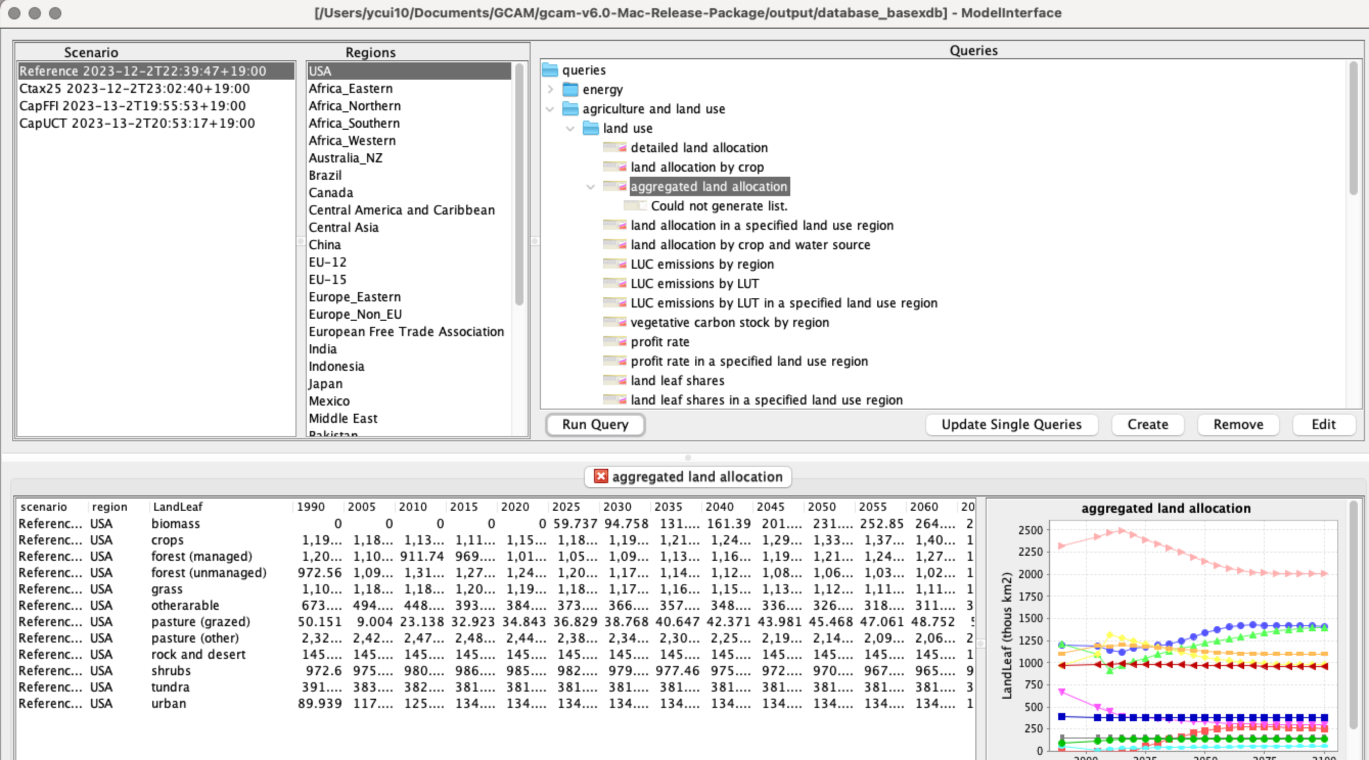
Land Allocation
http://jgcri.github.io/gcam-doc/details_land.html
Land allocation

Slide 16
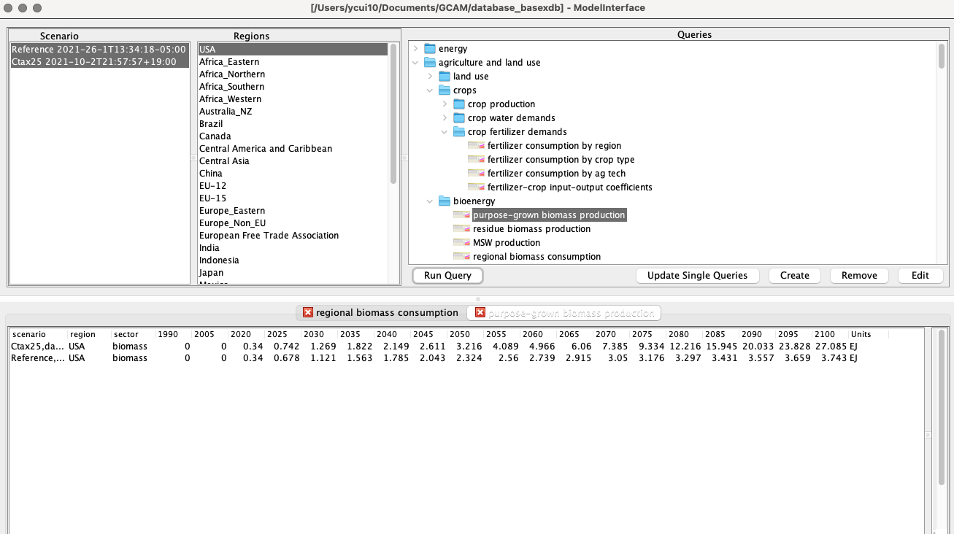
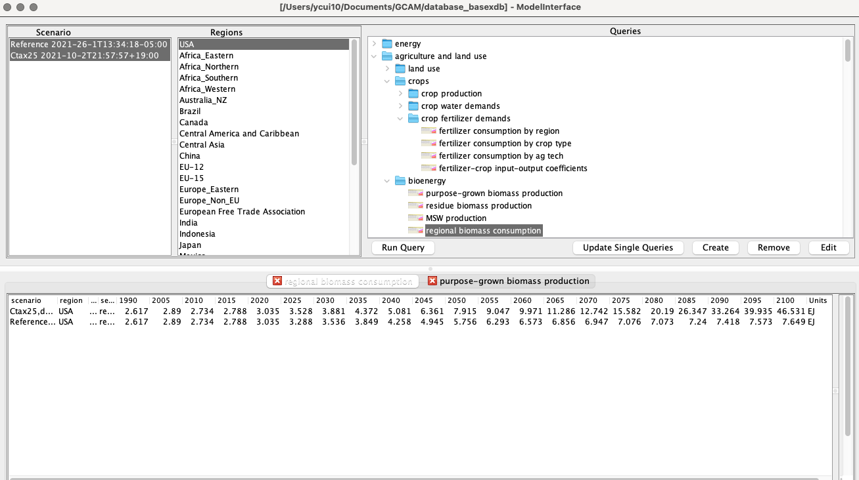
Energy linkages – Biomass and Fertilizer
Fertilizer:
Outputs of industry
Inputs of Ag
Biomass production
Biomass consumption

Slide 17
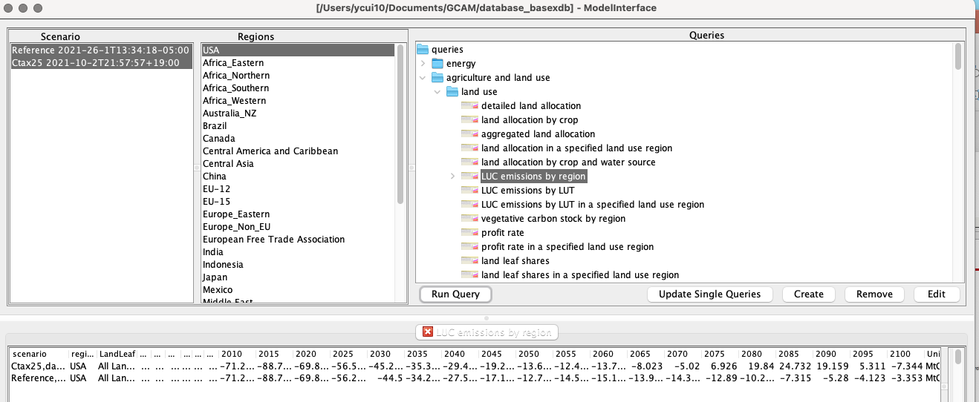
Land-Use Change Emissions
LUC Emissions
Why do LUC emissions go higher under carbon tax compared to the reference?

Slide 18
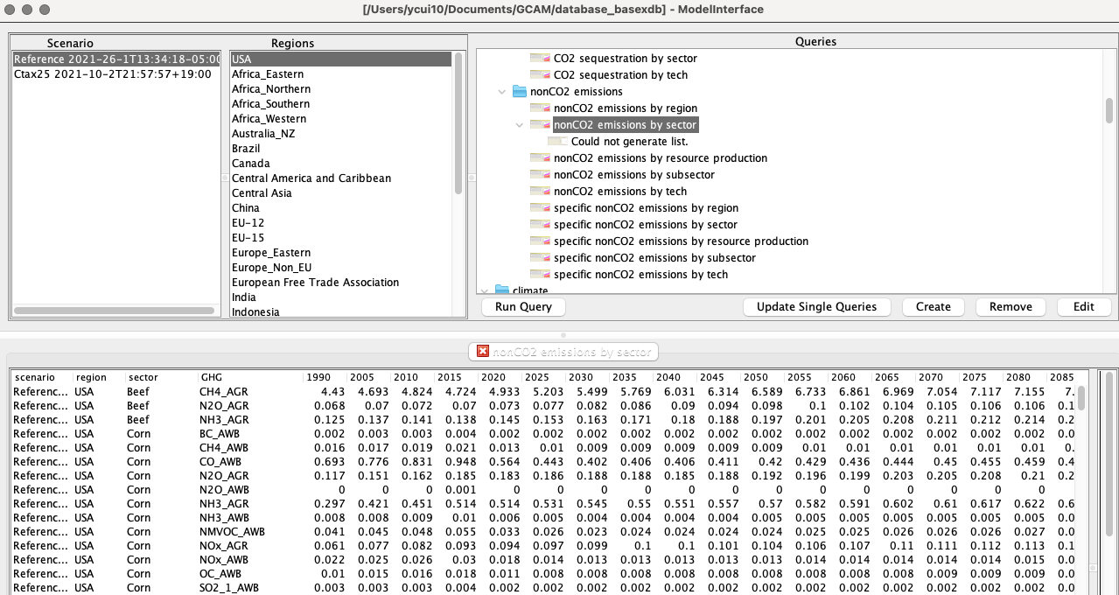
nonCO2 Emissions of Agriculture

Slide 19
Project proposal
Full project proposal is due on October 18. It should include the following components:
objective/questions of your project;
proposed scenarios;
methodology (assumptions, GCAM inputs to be used, edited);
data required and sources of information;
expected results and conclusions.
Feel free to send me an early idea to see if your proposal would be feasible.
E.g. don’t propose to model Mars climate.
Focus on one region and/or one sector.
Keep it simple, but with room to expand afterwards.

